Slide 1
OGZEB Hybrid Thermal Electrical
Energy Storage System
Spring 2014-Midterm 2 Presentation
Team members: Corey Allen, Anthony Cappetto, Lucas Dos Santos, Kristian Hogue, Nicholas Kraft, Tristian Jones, Artur Nascimento
Sponsors/Advisors: Dr. Li, Dr. Ordonez, Dr. Zheng
Date: 3-18-2014
Notes:
Good Afternoon everyone, we are team 23 working on the ogzeb. Introduce everyone and mention our sponsors.

Slide 2
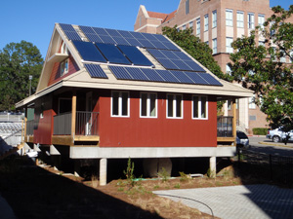
Outline
Scope/Objectives
Highlights & Progress
Thermal Prototype Design & Analysis
Grid-Tie Research
Challenges/Obstacles
Future Plans
Conclusions
Questions
Notes:
We’ll start with an overview of what we presented last time, then update you on the progress of the battery system. After that we’ll show you the development of the thermal energy storage system and present some procurement information, along with future plans, conclusions, and any questions you may have.

Slide 3
Scope & Objectives
Overall Scope:
Design energy storage system to store excess power generated by the house’s solar cells to be used at night.
Objectives:
Install and simulate new battery array.
Construct battery box gate mechanism for battery environmental control.
Compare experimental analysis to theoretical system analysis and discuss performance losses/possible improvements.
Examine possibility of grid connection
Notes:
To review midterm 1, our team was told to design an energy storage system to keep the OGZEB powered while the solar panels are inactive. The system should be a combination of thermal and electrical energy storage.

Slide 4
Highlights & Progress
Batteries have arrived, installation pending
Thermal Battery construction is complete and ready for simulation.
Chiller has been successfully tested for pump and chilling performance.

Slide 5
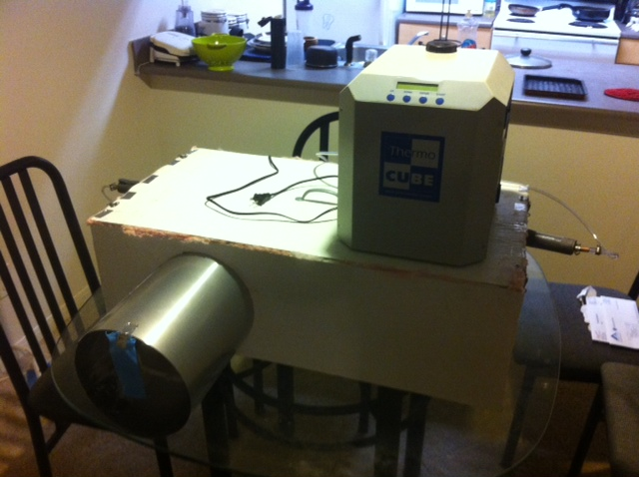
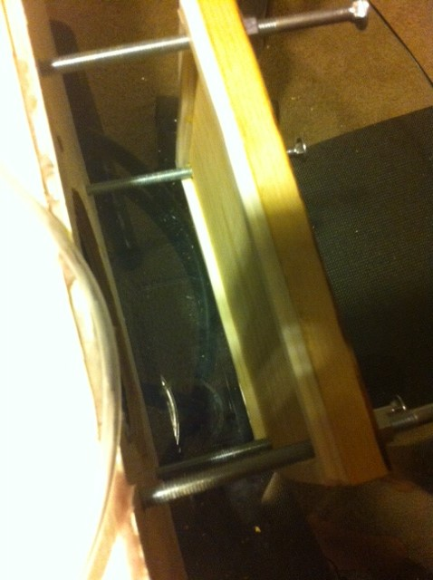
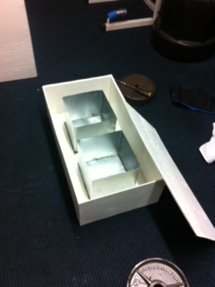
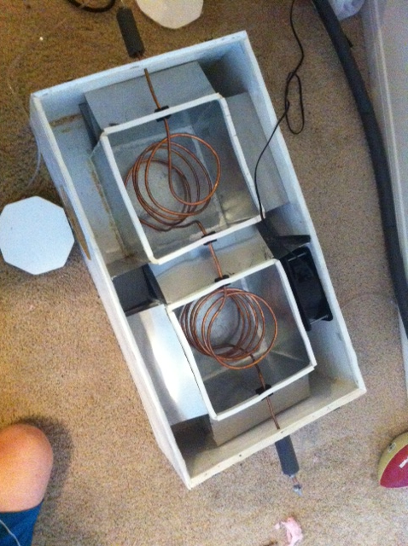
Thermal Battery Construction

Slide 6
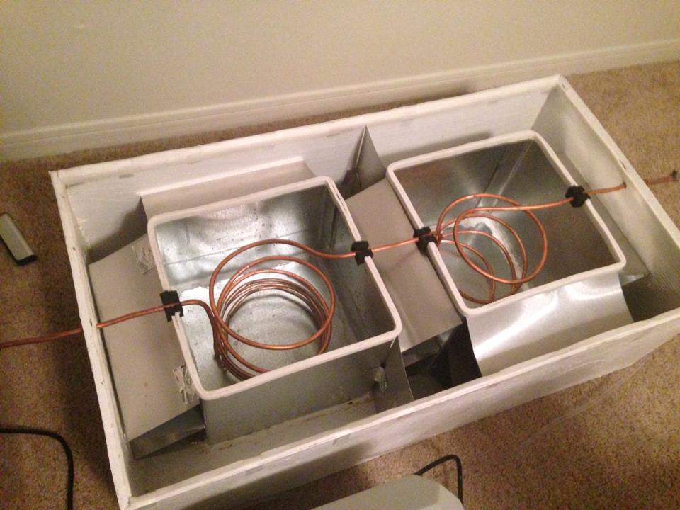
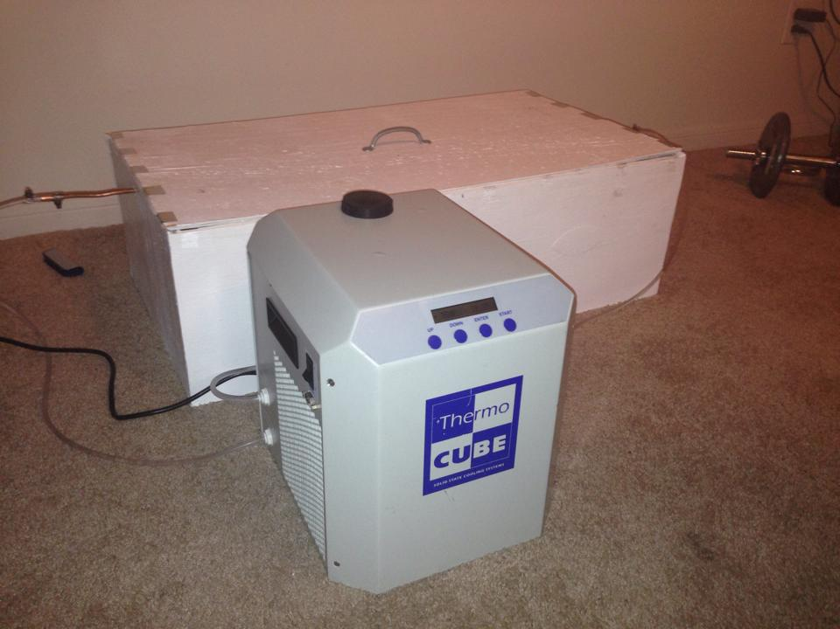
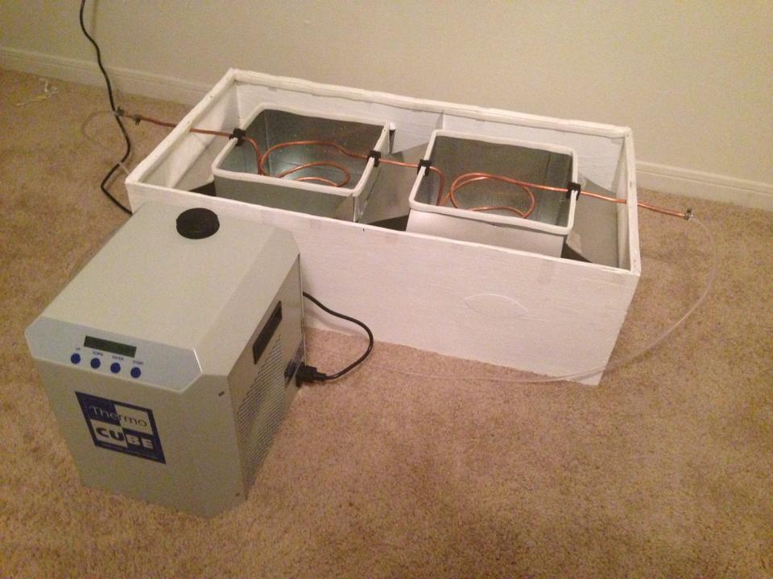
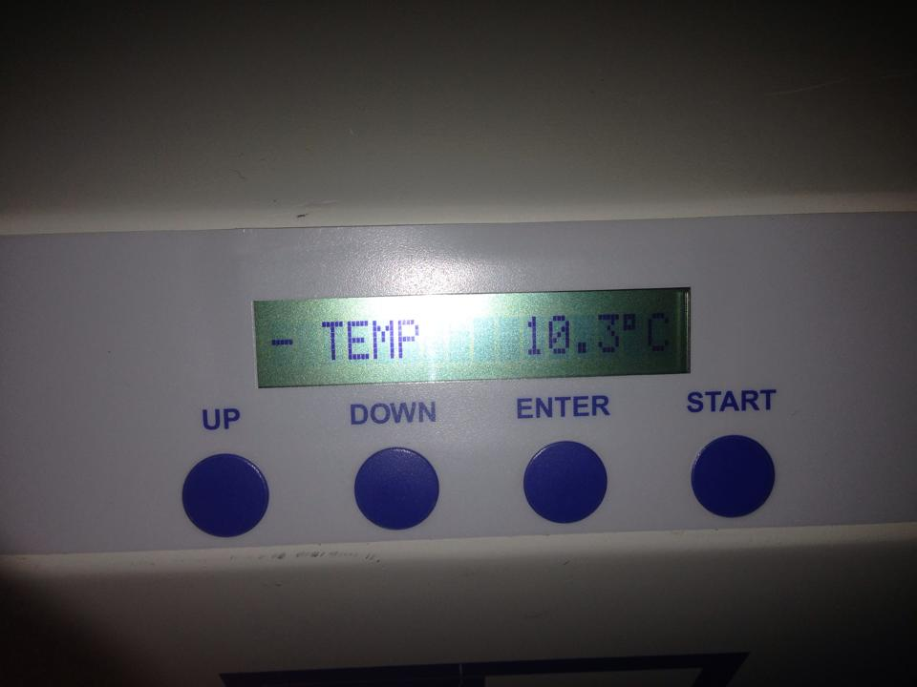
Preliminary Chiller Testing

Slide 7
New Thermal Battery Design & Original (Full-Size) Design

Slide 8
Final Design Concept & Major Changes
Recirculating Glycol/Water Chiller chills water and energy is stored via the chilling process.
Original design opted for 3 aluminum water tanks. The prototype will only consist of 2 tanks of a smaller volume: 10”x 10” x 9.4” (30.8L total).
Scaled down prototype uses triangular fin pattern (ease of construction) vs. a straight fin layout in full size design.
Wood with a water proof paint coating used in prototype while the final design will call for heavily insulated sheet metal.
Air will be propelled by a 365 CFM (3200rpm) fan. Full size system will require a 1200 CFM fan to create the required convection.
Inlet to scaled down system uses a sliding gate mechanism instead of a hinged door.

Slide 9
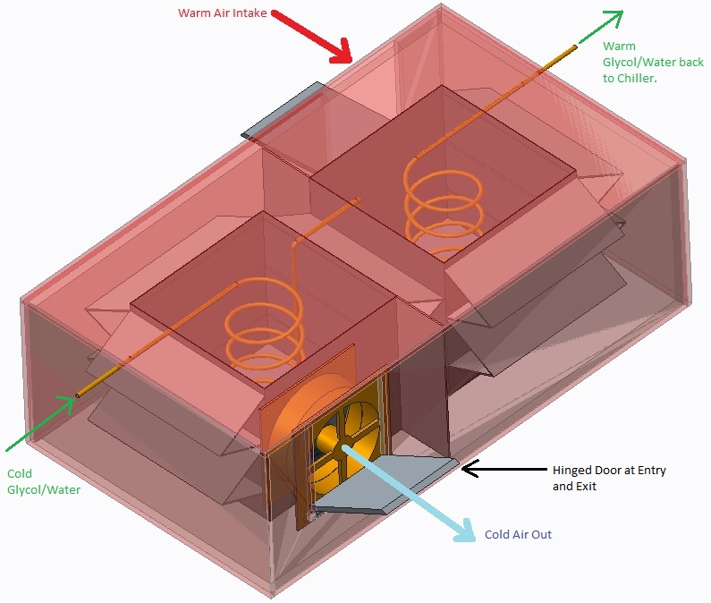
Thermal Battery Model

Slide 10
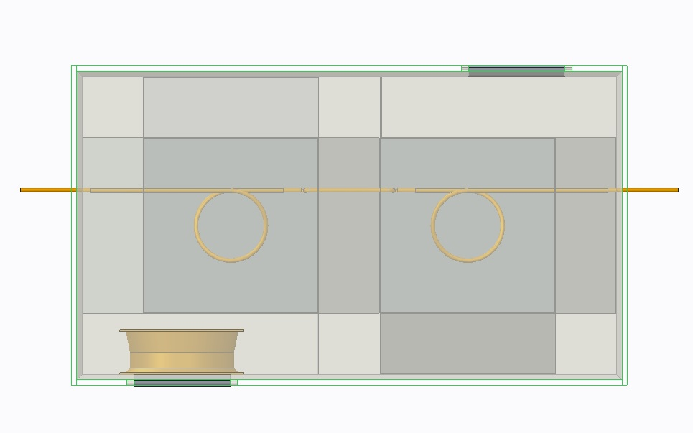
Thermal Battery Fluid Flow Model
Cold Air Out
*Melting (Discharge) Process
Cold
Glycol/Water
*Charging
Warm
Glycol/Water
*Charging
Hot Air Intake
*Melting (Discharge) Process
Insulation Layer

Slide 11
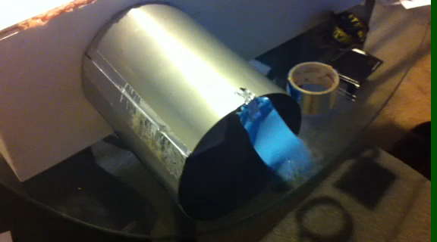


Airflow & Axial Fan

Slide 12
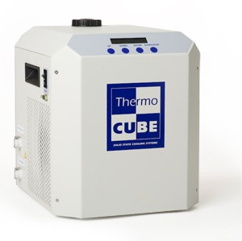
Chiller
Thermocube 300 Specifications
Operating Range: 5-50ᵒC Standard, down to -5ᵒC with low temp option.
Cooling Capacity: Dependant on Temperature set-point.
Process Fluid: Koolance (27% Propylene Glycol/water mix)
Size: 13” x 11” x 13”
Tank Volume: 300mL
Power Requirement: 115-230 VAC (50-60Hz)

Slide 13
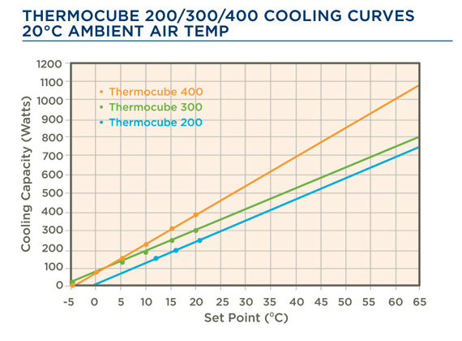
Thermal Battery- Chilling Analysis
Chiller selection criteria: Procured the most cost efficient chiller available for the budget situation at the time.
Heat dissipation of 2832 kJ required to bring water from 22ᵒC to 0ᵒC (10.3 MJ to freeze 30.8L water completely).
Neglected conduction heat transfer from surrounding air between the insulated boundary and water tanks.
Chilling time requirement of approximately 8 hours to bring water from 22ᵒC to 0ᵒC
Cooling Capacity at 0ᵒC Set Temperature
* Note: Latent Heat of Fusion & Specific Heat taken to be 334 kJ/kg & 4.18 KJ/kg*K.

Slide 14
Thermal Battery- Theoretical Cooling Analysis
Airflow: 365 CFM (0.17m³/s)
Straight fins with triangular layout (20 total) giving 329.3 W of cooling.
Non-finned surface area gives and additional 603.9 W giving a total cooling rate of 933.2 W (0.265 tons).
Enough to cool a room of 125 sq.ft. for 3.06 hours.
Adiabatic fin tip assumed:

Slide 15
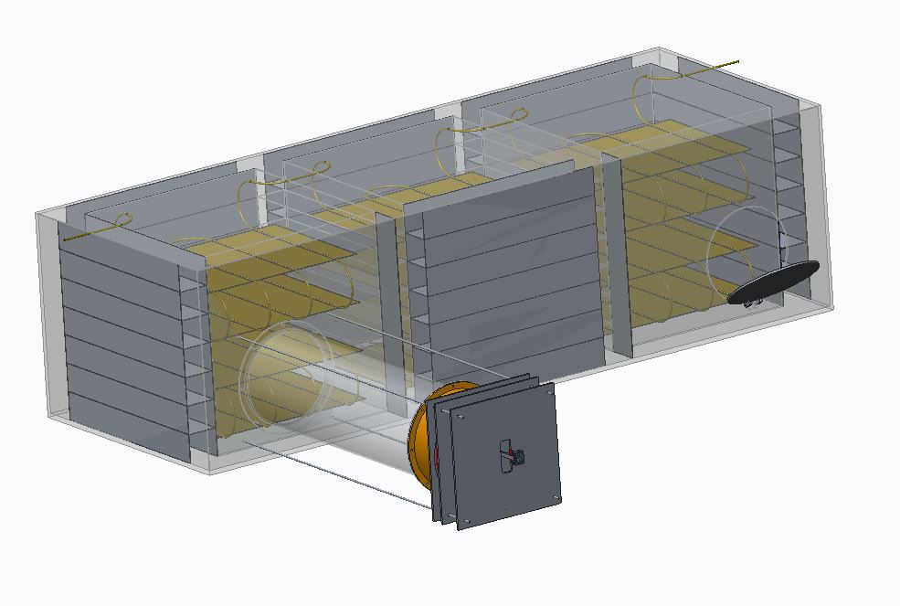
Full Size Model

Slide 16
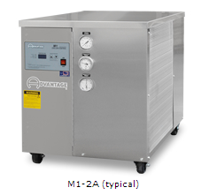
Full Size System Chiller Analysis
Chiller Model: M1-2A, Advantage Engineering
Quoted Cost: $6,455
Cooling Capacity: 2 Tons (7kW)
Compressor: 2 HP
Process Pump: ¾ HP, 4.8 GPM, 32 PSI, Centrifugal
Refrigerant: R-410A
Reservoir Capacity: 7.5 gal
Full Load Power Req: 230V/60Hz
Full Size System Requirement: 2 tons to freeze 758L of water in 12 hours.

Slide 17
Full Size System-Theoretical Cooling Analysis
House Requirement: 2 Tons for 1000sqft according to Alpine Home Air.
Full Size System will require a 1200 cfm (0.57m³/s) fan.
Fins will be of a straight rectangular pattern (42 total) and give a total heat transfer of 3.061kW.
Non-finned area will add an additional 4.363 kW of cooling which adds to just over the required 2 tons of cooling.
Main Parameters:
T_{b} = 0ᵒC
T∞ = 22ᵒC
mL = 3.014
t = 1.5875mm
L = 98.42mm
k_{aluminum} = 205 W/mK
k_{air} = 0.0257 W/mK
D_{h} = 0.931 m
Nu_{D} = 552.87
h = 42.38 W/m²K

Slide 18
Potential Improvements
Finned copper tubing or tube sheets for a more uniform ice distribution within the aluminum tanks (Shown in full size model)
Size reduction and space consumption (potentially make chiller and storage system one single entity)
Improve airflow throughout system (less pressure loss)
Cost reduction (2 ton chiller cost: $6,455)

Slide 19
Grid-Tie System Research

Slide 20
How Grid-Tie Systems Work
Grid-tied systems route solar electricity to a utility grid that allows the customer to:
Consume solar power when it is available and the utility grid is working.
Purchase electricity from the grid when sun does not shine.
Sell excess of solar power to the grid and receive a credit for exporting power
(net metering).

Slide 21

Why Grid-Tie Systems
Financially viable
Environmentally friendly power
Producing power where it is consumed
Protection against fluctuating power prices
Simple maintenance

Slide 22
What’s Needed
Grid interactive Inverter/charger
Net Meter - Bi-directional meter that registers in/out kWh’s
DC and AC disconnects – switches to turn power on/off for safety
PV Interconnect Agreement – An agreement required by Tallahassee Utility that provides detailed information about the PV system.
Building and electrical Inspections
Electricians for installation

Slide 23

Interactive Inverter
Most important piece of equipment
Routes electricity intelligently
Sets voltage to specific voltage
Converts DC to AC and matches with grid
3 scenarios for routing electricity

Slide 24

Net Meter
Keeps track of in/out kWh
Reads negative, positive, or zero
Earns credit toward utility bill
No extra cost for installing

Slide 25
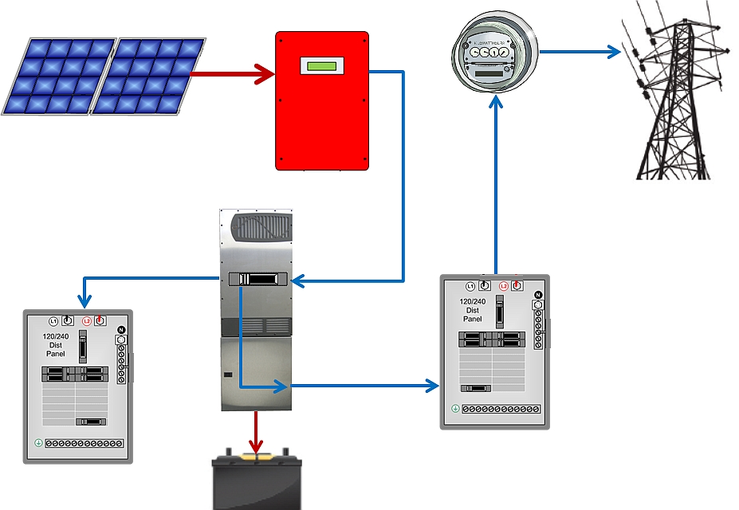
Simple Diagrams
Scenario 1: Sun shines and Grid is operating
Sunnyboy Inverter
Bi Directional Meter
Sets voltage point for batteries using MPPT (Maximum power point tracking)
Reroutes some excess power from panels to grid for kWh credits
PV Panel
Interactive Grid Inverter
Utility Service Panel
Home Panel
Battery bank

Slide 26
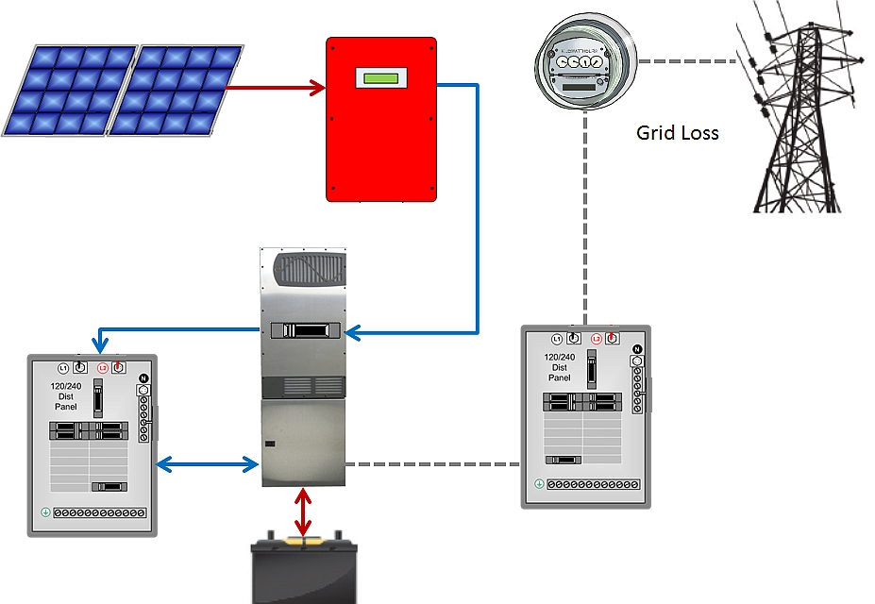
Simple Diagrams
Scenario 2: Sun shines and Grid is lost
Bi Directional Meter
Sunnyboy Inverter
PV Panel
Batteries are used to power the inverter
House is running off batteries and PV panels
Interactive Grid Inverter
Utility Service Panel
Home Panel
Battery bank

Slide 27
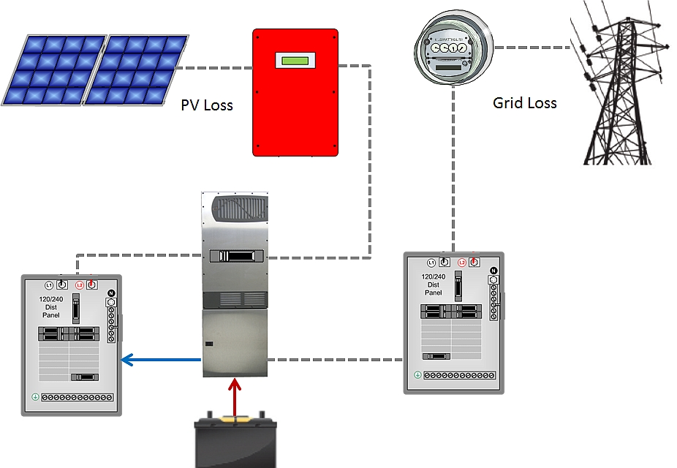
Simple Diagrams
Scenario 3: No sun and Grid is lost
Bi Directional Meter
Sunnyboy Inverter
Batteries power the inverter and critical loads of the house
PV Panel
Interactive Grid Inverter
Utility Service Panel
Home Panel
Battery bank

Slide 28
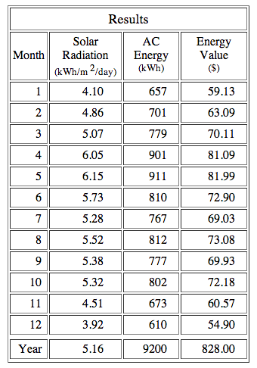

Value of Energy
Results show Energy value of total power produced from panels with specifications of the OGZEB

Slide 29
What Next?
Inverter needs to be chosen
In depth power flow analysis for house
Establish electrical layout of the OGZEB

Slide 30
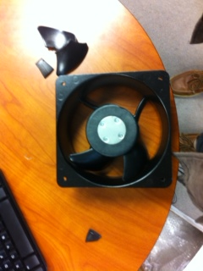

Obstacles/Safety
Time constraints-
  Full testing/Adjustments of system must be complete within 2-3 weeks.
  Battery box reservoir and gate mechanism still in construction process.
Student reimbursement- Money was spent out of pocket by different team members.
Must be sure to maintain safety measures when testing the fan and displaying the prototype as the blades are very sharp.

Slide 31
Future Plans
Testing of Thermal Battery
Installation of battery array
Adjustments to full size thermal system and cost reduction possibilities
Grid connection implementation

Slide 32

Questions?

